Slide 1
Chapter 3: Solving Problems by Searching
Uniformed Search

Slide 2
Chapter 2 Summary
Agents interact with environments through actuators and sensors
The agent function describes what the agent does in all circumstances
The agent program calculates the agent function
A perfectly rational agent maximizes expected performance
PEAS descriptions define task environments
Environments are categorized along several dimensions:
Observable? Deterministic? Episodic? Static? Discrete? Single-agent?

Slide 3
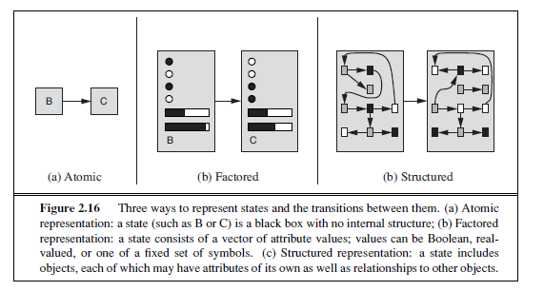
Problem-Solving Agents
Goal-based agents versus reflex agents
Reflex agents base their actions on a direct mapping from states to actions.
Goal-based agents consider the future actions and their outcomes to achieve a certain goal.
Problem-solving agent is a goal-based agent that consider atomic representation for the world states.
Notes:
This chapter addresses a single category of problems: observable, deterministic, known environments
where the solution is a sequence of actions.

Slide 4
Problem-Solving Agents
Goal formulation.
Problem formulation.
We assume observable, deterministic, discrete, and known environments.
The solution to a search problem would be a sequence of actions.
Then, the agent can execute the solution.
“Formulate- Search- Execute” agent.
Notes:
Open-loop systems

Slide 5
Problem-Solving Agents
This offline problem solving!
Solution is executed “eyes closed.
This is the hard part!
Notes:
while the agent is executing the solution sequence it ignores its percepts
when choosing an action because it knows in advance what they will
Open loop system (ignoring percepts opens the loop between the agent and environment)

Slide 6
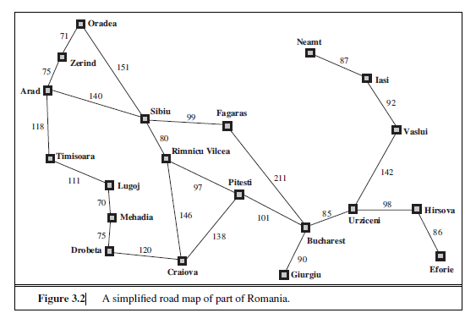
Problem formulation
The goal of this agent is to travel from Arad to Bucharest.
Initial state
The state where the agent starts. In(Arad)
Actions(s)
Possible actions available to the agent at state s. From Arad: Go(Sibiu), Go(Zerind),
Go(Timisoara)
Transition model (successor function): A description of what each action does.
Results(s,a) returns the state resulting from applying action a at state s.
Result(In(Arad),Go(Zerind))=In(Zerind)
Goal test: Determines if a certain state is a goal state. In(Bucharest)
Path cost function: Assigns a cost to a path. Summation of step costs of actions along the path.
Step cost: c(s,a,s’)

Slide 7
Problem formulation (cont.)
Solution
A solution to a problem is an action sequence that leads from the initial state to a goal state. Solution quality is measured by the path cost function.
Optimal Solution
The optimal solution has the lowest path cost among all solutions.
Notes:
Compare the simple state description we have chosen, In(Arad), to an actual crosscountry
trip, where the state of the world includes so many things: the traveling companions,
the current radio program, the scenery out of the window, the proximity of law enforcement
officers, the distance to the next rest stop, the condition of the road, the weather, and so on.
All these considerations are left out of our state descriptions because they are irrelevant to the
problem of finding a route to Bucharest. The process of removing detail from a representation
ABSTRACTION is called abstraction.

Slide 8
Abstraction
Abstraction is removing details from a representation.
For the trip from Arad to Bucharest, compare the previous problem formulation to the real world states.
The real world state includes so many things: the traveling companions, the current radio program, the scenery out of the window, the distance to the next rest stop, the condition of the road, the weather, and so on.
Abstract the actions also!
Omit all irrelevant actions: turning on the radio, looking out of the window, and so on.
And do not specify actions at the level of “turn steering wheel to the left by one degree”.

Slide 9
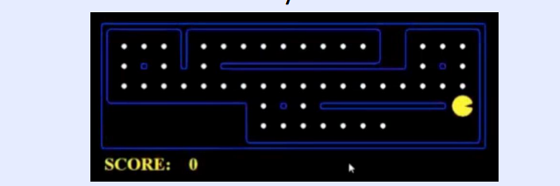
Abstraction- example
The world state includes every last detail of the environment
A search state keeps only the details needed for planning (abstraction)
Assume no ghosts for the two problems.
Problem: Pathing
States: (x,y) location
Actions: NSEW
Successor: update location only
Goal test: is (x,y)=END
Problem: Eat-All-Dots
States: {(x,y), dot booleans}
Actions: NSEW
Successor: update location and possibly a dot boolean
Goal test: dots all false
Notes:
Wrong example for “eat-all-dots”: (x, y, dot count)

Slide 10
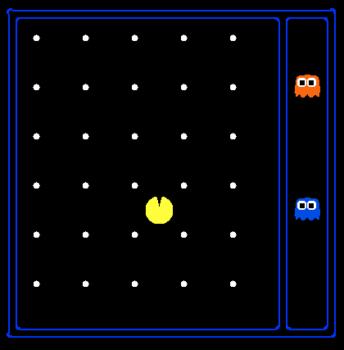
State Space Sizes?
World state:
Agent positions: 120
Food count: 30
Ghost positions: 12
Agent facing: NSEW
How many
World states?
120x(2³⁰)x(12²)x4
States for pathing?
120
States for eat-all-dots?
120x(2³⁰)
Notes:
90 * (2^30-1) + 30 * 2^29 = 145 billion
2^29 = 536 870 912

Slide 11
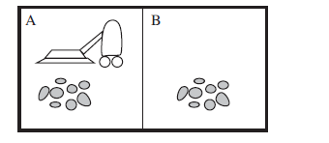
Toy Problems: Vaccum Cleaner
States: The state is determined by both the agent location and the dirt locations.
The agent is in one of two locations, each of which might or might not contain dirt.
Thus, there are 2 × 2² = 8 possible world states.
A larger environment with n locations has n ・ 2^{n} states.
• Initial state: Any state can be designated as the initial state.
• Actions: In this simple environment, each state has just three actions: Left, Right, and Suck.
• Transition model: The actions have their expected effects, except that moving Left in
the leftmost square, moving Right in the rightmost square, and Sucking in a clean square
have no effect.
• Goal test: This checks whether all the squares are clean.
• Path cost: Each step costs 1, so the path cost is the number of steps in the path.

Slide 12
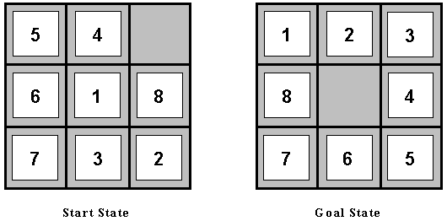
Toy Problems: 8-puzzle problem
Initial State: The location of each of the 8 tiles in one of the nine squares
Operators: blank moves (1) Left (2) Right (3) Up (4) Down
Goal Test: state matches the goal configuration
Path cost: each step costs 1, total path cost = no. of steps

Slide 13
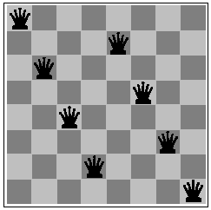
Toy Problems: 8-queens problem
Fig 4.7
Initial State: Any arrangement of 0 to 8 queens on board.
Operators: add a queen to any square.
Goal Test: 8 queens on board, none attacked.
Path cost: not applicable or Zero (because only the final state counts, search cost might be of interest).

Slide 14
Real-world Problems
Route Finding - computer networks, automated travel advisory systems, airline travel planning.
VLSI Layout - A typical VLSI chip can have as many as a million gates, and the positioning and connections of every gate are crucial to the successful operation of the chip.
Robot Navigation - rescue operations
Mars Pathfinder - search for Martians or signs of intelligent lifeforms
Time/Exam Tables

Slide 15
State Space Graphs
State space graph: A mathematical representation of a search problem
Nodes are (abstracted) world configurations
Arcs represent successors (action results)
The goal test is a set of goal nodes (maybe only one)
In a search graph, each state occurs only once!
We can rarely build this full graph in memory (it’s too big), but it’s a useful idea
a
G
b
c
e
d
f
S
h
p
q
r
Tiny search graph for a tiny search problem
Notes:
We have formulated problems, but how to solve them?
Find solution without writing most of the graph down.
really care about the start and what you can do from the start -> search tree

Slide 16



Search Trees
This is now / start
“N”, 1.0
“E”, 1.0
Possible futures
A search tree:
A “what if” tree of plans and their outcomes
The initial sate is the root node
Children correspond to successors
Nodes show states, but correspond to PLANS that achieve those states
For most problems, we can never actually build the whole tree
Notes:
Different plans that achieve the same state, will be different nodes in the tree.
Every plan in the tree.
Search ignores most of the tree.

Slide 17
State Space Graphs vs. Search Trees
State Space Graph
Each NODE in the search tree is an entire PATH in the state space graph.
Search Tree
S
a
G
d
e
p
b
c
q
b
c
e
h
r
d
e
f
a
a
h
r
p
q
f
S
h
We construct both on demand – and we construct as little as possible.
p
q
f
q
c
G
p
q
r
q
c
G
a
a

Slide 18

State Space Graphs vs. Search Trees
Consider this 4-state graph:
How big is its search tree (from S)?
a
S
G
b

Slide 19
State Space Graphs vs. Search Trees
Consider this 4-state graph:
How big is its search tree (from S)?
a
s
a
b
S
G
b
G
a
G
b
a
G
b
G
…
…
Important: Lots of repeated structure in the search tree!
Notes:
Graph is only 4, tree is infinite!

Slide 20
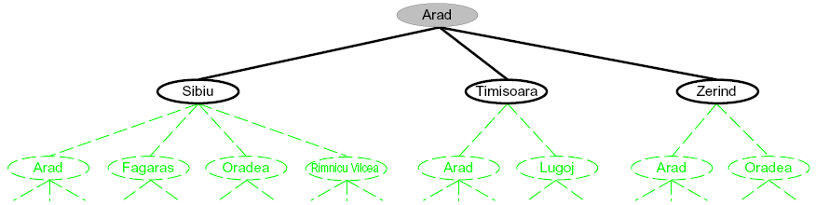
Searching with a Search Tree
Search:
Expand out potential plans (tree nodes)
Maintain a frontier of partial plans under consideration
Try to expand as few tree nodes as possible
Notes:
Haven’t constructed green stuff yet. It exists and is mathematically defined, but we haven’t actually constructed it / explored it yet.
Build downward.

Slide 21
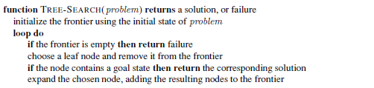
General Tree Search
Important ideas:
Frontier: the set of leaf nodes available for expansion at any given point.
Expansion
Main question: which frontier nodes to expand?

Slide 22
Tree Search: Extra Work!
Failure to detect repeated states can cause exponentially more work.
State Graph
Search Tree
Notes:
Exponential unrolling. Generally what happens.
May need to consider both paths to B, but what’s underneath B is the same.
Should be able to save the work.

Slide 23
Graph Search
Algorithms that forget their history are doomed to repeat it.
How to avoid exploring redundant paths in Tree Search?
Add a data structure called the explored set to save every expanded node. Newly generated nodes that match previously generated nodes—ones in the explored set or the frontier—can be discarded instead of being added to the frontier.

Slide 24
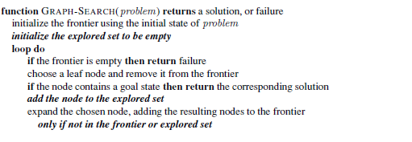
Graph Search (cont.)

Slide 25
Evaluating Search Algorithms
Each of the search strategies are evaluated based on:
Completeness: is the strategy guaranteed to find a solution when there is one?
Time complexity: how long does it take to find a solution?
(Measured in terms of number of nodes generated during the search.)
Space complexity: how much memory does it need to perform the search?
(Measured in terms of the maximum number of nodes stored in memory.)
Optimality: does the strategy find the lowest path cost solution when there are several solutions?

Slide 26
Complexity Notation
The complexity is expressed in terms of three quantities:
b: the branching factor or maximum number of successors of any node
d: the depth of the shallowest goal node (i.e., the number of steps along the path from the root)
m: the maximum length of any path in the state space.

Slide 27
Uninformed Search Strategies
The uninformed search strategies have no additional information about states beyond that provided in the problem definition
Thus, they can only distinguish a goal state from a non-goal state, and they cannot tell how far a state from the goal.
Examples:
Breadth-first Search
Uniform Cost Search
Depth-first Search
Depth-limited Search
Iterative deepening
Bi-directional Search
Notes:
The UNINFORMED term means that the strategies have no additional
SEARCH information about states beyond that provided in the problem definition. All they can do is
generate successors and distinguish a goal state from a non-goal state. All search strategies
are distinguished by the order in which nodes are expanded.

Slide 28
Breadth-First Search
Strategy: expand the shallowest node first
All nodes at a certain level are expanded before the next level nodes.
Frontier Data structure?
FIFO queue
a
G
b
c
d
e
f
S
h
p
q
r
S
d
e
p
Search
Tiers
b
c
e
h
r
q
a
a
h
r
p
q
f
p
q
f
q
c
G
q
c
G
a
a
Notes:
Same general algorithm. Shallowest node.
S D E P B C E H R Q

Slide 29
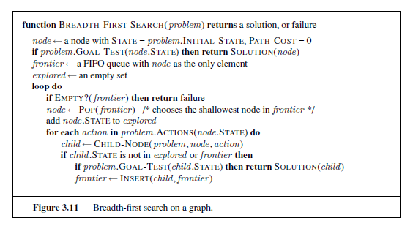
Breadth-First Search
Why do we add goal test here not when the node is chosen for expansion?
Notes:
Child node must have a pointer to the parent node to construct the solution when reaching the goal.
Child node has state, parent pointer, and path cost.

Slide 30
Breadth-First Search (BFS) Properties
What nodes does BFS expand?
Processes all nodes above shallowest solution
Let depth of shallowest solution be d
Search takes time O(b^{d})
The complexity would be O(b^{d+1}) if the goal test is applied when the node is chosen for expansion.
How much space does the frontier take?
Has roughly the last tier, so O(b^{d})
Is it complete?
d must be finite if a solution exists, so yes!
Is it optimal?
If the path cost is a nondecreasing function of the depth of the node (for example if all actions have the same cost).
1 node
b
…
b nodes
d tiers
b² nodes
b^{d} nodes
b^{m} nodes
b is the branching factor
m is the maximum depth
solutions at various depths

Slide 31
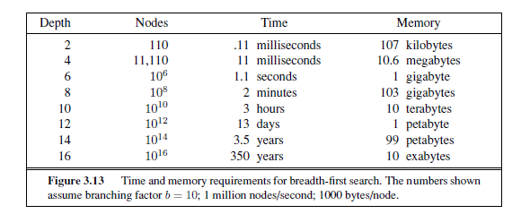
Breadth-First Search (BFS)
Memory requirements are a major problem for BFS.
Time requirement is also a big problem. (check depth 14,16).

Slide 32
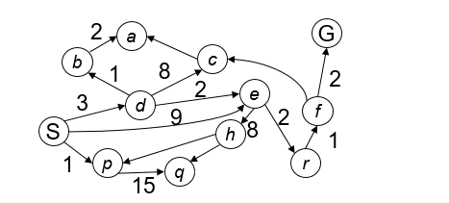
Uniform-Cost Search
Strategy: expand the cheapest node first.
(The lowest path cost)
Frontier Data structure?
A priority queue (priority: cumulative cost (path cost))
0
S
d
3
e
9
p
1
b
4
e
5
h
17
r
11
q
16
c
11
Cost contours
a
6
a
h
13
r
7
p
q
f
p
q
f
8
q
c
G
q
c
a
11
G
10
a

Slide 33
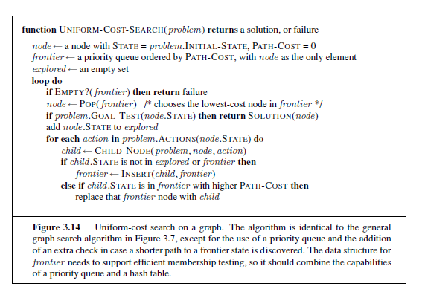
Uniform-Cost Search
Observe the differences from BFS algorithm!
Why goal test is done when the node is expanded?
In case a better path is found to a node in the frontier.
Notes:
To guarantee optimality
There may be a goal node on a sub-optimal path,

Slide 34
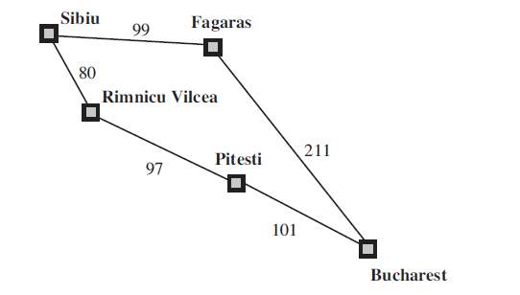
Uniform Cost Search Example
Apply UCS algorithm to the search problem
From Sibiu to Bucharest.
Sibiu
80
99
Fagaras
Rimnicu Vilcea
97+80=177
99+211=310
Pitesti
177+101=278
Bucharest
Bucharest
Notes:
Section 3.4.2

Slide 35
Uniform Cost Search (UCS) Properties
Uniform-cost search is guided by path costs rather than depths, so its complexity is not easily characterized in terms of b and d.
What nodes does UCS expand?
Processes all nodes with cost less than cheapest solution!
If that solution costs C* and arcs cost at least ε , then the “effective depth” is roughly C*/ε
Takes time O(b^{C*/ε}) (exponential in effective depth)
How much space does the frontier take?
Has roughly the last tier, so O(b^{C*/ε})
Is it complete?
Assuming best solution has a finite cost and minimum arc cost is positive, yes!
Is it optimal?
Yes!
b
c ≤ 1
…
C*/ε “tiers”
c ≤ 2
c ≤ 3

Slide 36
Uniform Cost Search Issues
UCS is complete and optimal!
UCS Issues :
Explores options in every “direction”
No information about goal location
Start
Goal

Slide 37
Depth-First Search
Strategy: expand the deepest node first.
Frontier Data structure?
A LIFO stack
a
G
a
c
b
c
b
e
d
e
d
f
f
S
h
h
p
p
r
q
r
q
S
d
e
p
b
c
e
h
r
q
a
a
h
r
p
q
f
p
q
f
q
c
G
q
c
G
a
a

Slide 38
Depth-First Search (DFS) Properties
What nodes DFS expand?
Some left prefix of the tree.
Could process the whole tree!
If m is finite, takes time O(b^{m})
How much space does the frontier take?
Only has siblings on path to root, so O(bm)
Is it complete?
The graph search version (no repeated states) is complete in finite spaces, but tree search is not complete.
Is it optimal?
No, it finds the “leftmost” solution, regardless of the cost
1 node
b
…
b nodes
b² nodes
m tiers
b^{m} nodes

Slide 39
Depth-first Search
Depth-first search main advantage is its space complexity O(bm) for a maximum depth m.
DFS issues:
It can get stuck going down the wrong path.
Many problems have very deep or even infinite search trees.
DFS should be avoided for search trees with large or infinite maximum depths.
Notes:
It is common to implement a DFS with a recursive function that calls itself on each of its children in turn.

Slide 40
Depth-limited Search
Depth limited search avoids the pitfalls of DFS by imposing a cutoff on the maximum depth l.
However, if we choose a depth limit that is too small (l<d), then DLS is not even complete.
The time and space complexity of DLS is similar to DFS.
Completeness: Yes, if l >= d
Time complexity: b^{l}
Space complexity: bl
Optimality: No (b-branching factor, l-depth limit)

Slide 41
Iterative Deepening
Idea: get DFS’s space advantage with BFS’s time / shallow-solution advantages
Run a DFS with depth limit 1. If no solution…
Run a DFS with depth limit 2. If no solution…
Run a DFS with depth limit 3. …..
Isn’t that wastefully redundant?
Generally most work happens in the deepest level searched.
b
…

Slide 42
Iterative Deepening
The hard part about depth-limited search is picking an appropriate depth limit.
Iterative deepening is a strategy that resolves the issue of choosing the best depth limit by trying all possible depth limits: first depth 0, then depth 1, the depth 2, and so on until a goal is found.
In effect, it combines the benefits of DFS and BFS.
It is complete like BFS and has modest memory requirements of DFS.

Slide 43
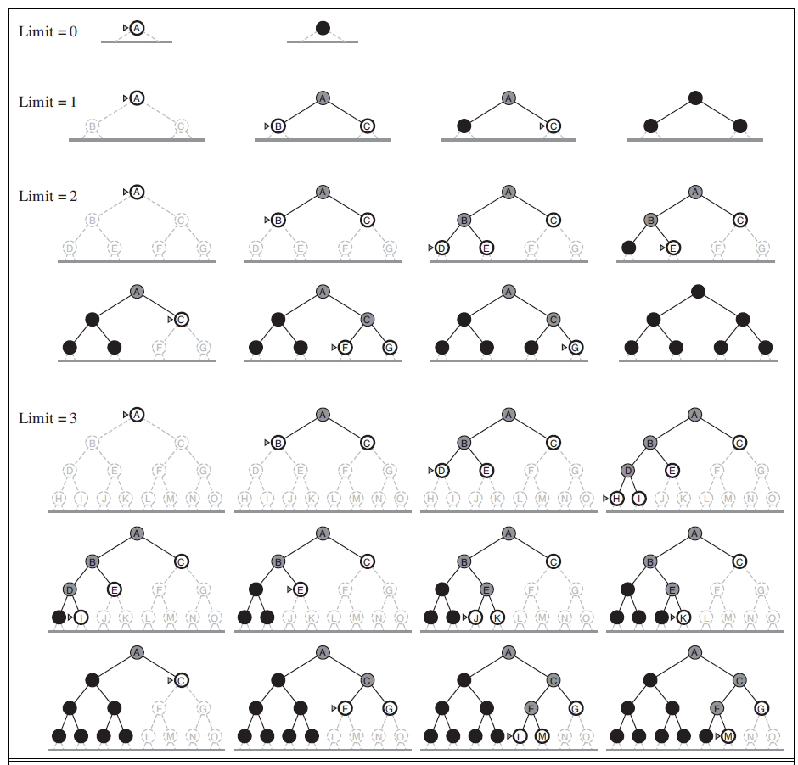
Iterative Deepening

Slide 44
Bi-directional Search
Search forward from the Initial state
And search backwards from the Goal state..
Stop when two meet in the middle.
(The frontiers of the two searches intersect; means a solution is found.)
Completeness: Yes
Time complexity: b^{d/2}
Space complexity: b^{d/2}
Optimality: Yes

Slide 45
Bi-directional Search Issues
How do we search backward?
Not all actions are reversible.
There could be multiple goal states.
Then construct a new dummy goal state whose immediate predecessors are all the actual goal states.
The goal can be an abstract description like n-queens search problem (“no queen attacks another queen”, then bidirectional search is difficult to use.

Slide 46
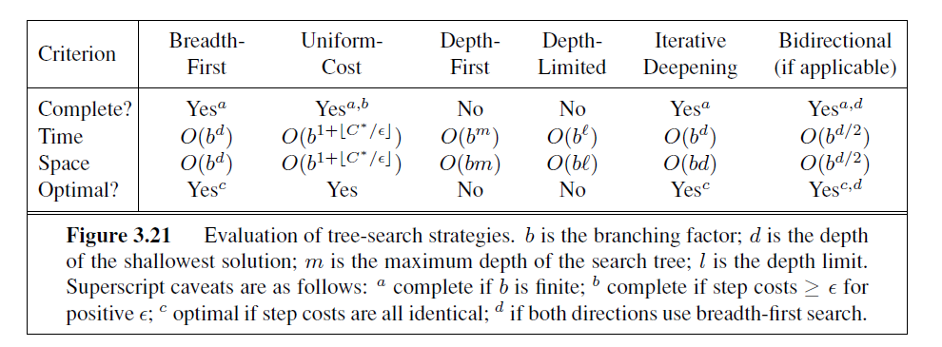
Comparing Uninformed Search Strategies

Slide 47
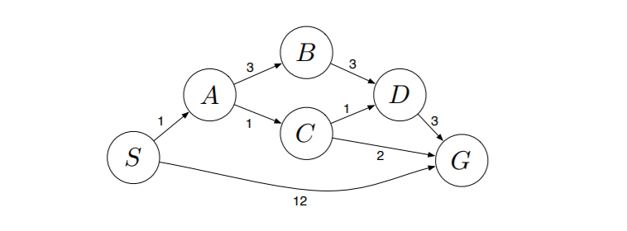
Example
Apply BFS, DFS, and UCS to the following problem:

Slide 48
Summary
Problem-Solving Agents
Search Problem Formulation
Graph Search vs. Tree Search
Evaluating Search algorithms performance.
Uninformed Search Strategies

